Slide 1
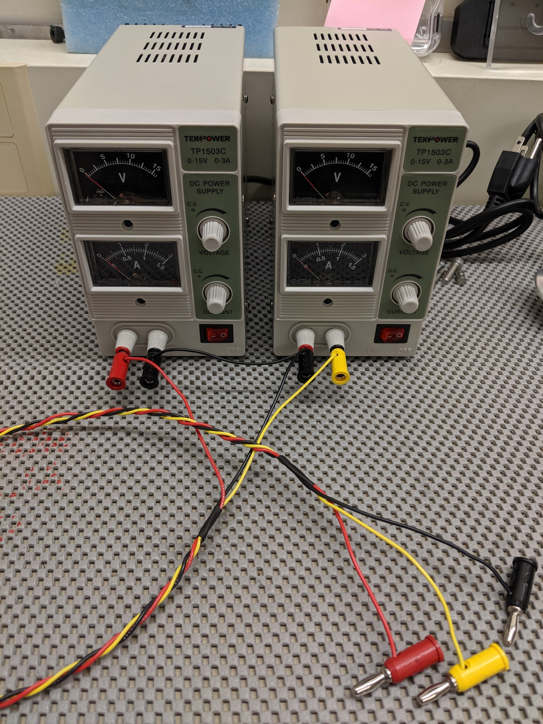
GND
V+
V-
GND
V-
V+

